Slide 1
Unit Testing in Angular
COURSE INTRODUCTION

Slide 2

Introduction
Goal
Demo application
Testing & unit testing overview
Tooling
Isolated unit tests Integration tests
Testing DOM interaction & routing components
Advanced topics
Agenda

Slide 3
Course Goal
Learn Angular Unit Testing
Good unit tests Isolated vs. integration tests

Slide 4
End to end testing
Testing tools
This Is Not
About
TDD/Test first vs. test after

Slide 5
Basic understanding of Angular
Basic understanding of the web
Prerequisites

Slide 6
The Demo Application

Slide 7

Demo
Tour of Heroes
- Modified
Don’t worry about package versions

Slide 8
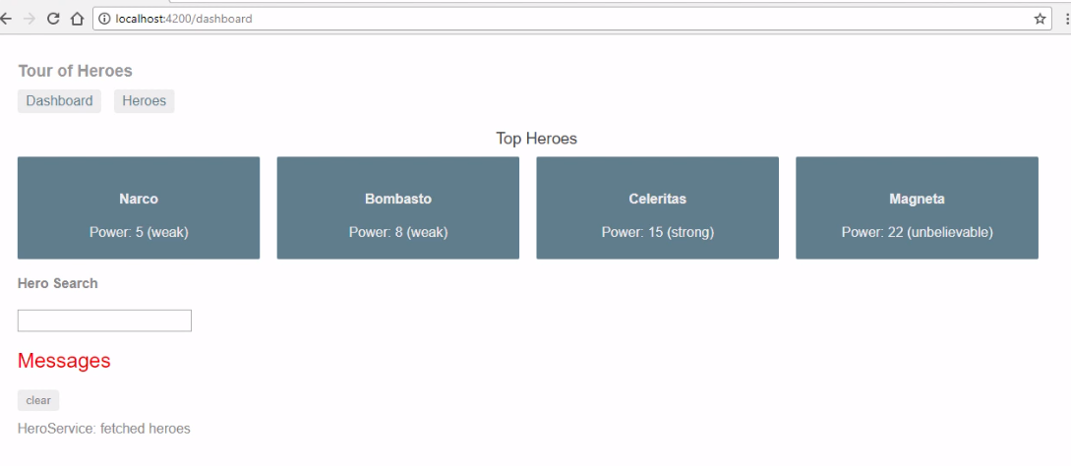

Slide 9
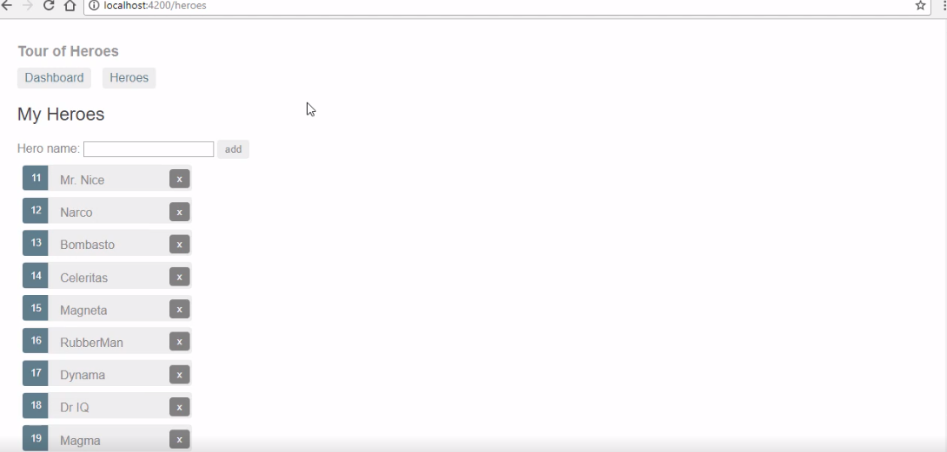

Slide 10
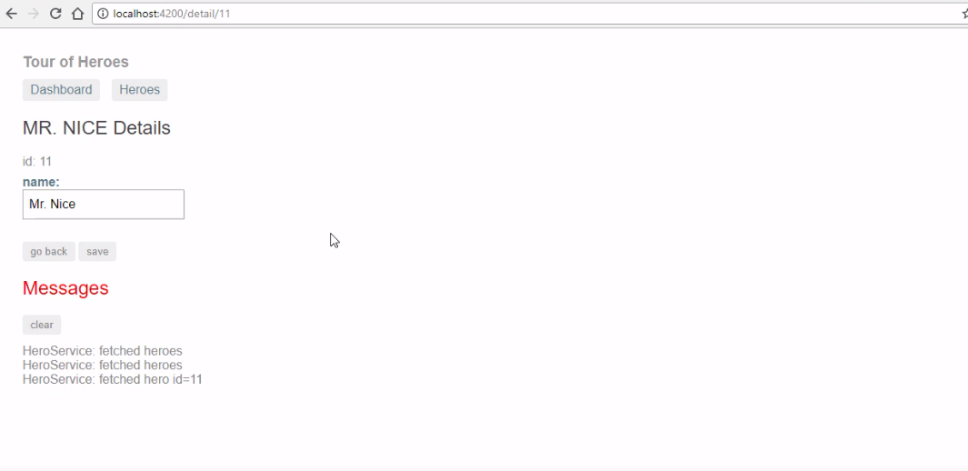

Slide 11
Testing Overview

Slide 12
Unit testing
End to end testing
Automated Testing
Integration or functional testing

Slide 13
Live running application
End to End Testing
Tests exercise live
application

Slide 14
A single “unit” of
code
Unit Testing

Slide 15
More than a unit, less than the complete application
Integration and Functional Testing

Slide 16


End to End Testing
Live Application
Web Server
End to End Tests
Front End
Db

Slide 17
Integration and Functional Testing
Front End
Integration Tests
User Component
User Service

Slide 18
Unit Testing
Unit Tests
User Component
User Helper

Slide 19
Angular Integration Testing
Component
User Component
Angular Integration Tests
User Component Template

Slide 20
Mocking

Slide 21
Mocking
Unit Tests
User Component
Mock User Service
User Service

Slide 22
Dummies
Stubs
Spies True mocks
Types of Mocks

Slide 23
Unit Tests in Angular

Slide 24
Isolated
Integration
Types of Unit Tests in Angular
Shallow
Deep

Slide 25
Tools of Unit Testing with Angular

Slide 26
Karma
Jasmine
Tools We Will
Use

Slide 27
Jest
Mocha/Chai/etc Sinon
Other Unit Testing Tools
TestDouble
Wallaby Cypress
End to end tools

Slide 28
Writing Good Unit Tests

Slide 29
Arrange all necessary preconditions and inputs
Structuring
Tests
Act on the object or class under test
Assert that the expected results have occurred

Slide 30
DRY (don’t repeat yourself)
Remove duplication
DAMP
Repeat yourself if necessary
DAMP vs. DRY

Slide 31
A test should be a complete story, all within the it()
You shouldn’t need to look around much to understand the test
Techniques
Move less interesting setup into beforeEach()
Keep critical setup within the it()
Include Arrange, Act, and Assert inside the it()
Tell the Story

Slide 32
Demo application
Summary
Tour of heroes
Testing
Unit testing
Isolated, integration, shallow and deep
Karma and Jasmine Telling the story

